Slide 1
CED Budget Analysis
4/11 Update
BU Spark! DS 594

Slide 2
Progress Made
Identified top 10 departments of interest using feasibility rankings and chart of 2022 departments with positive surplus
Manually retrieved Personnel vs. Non Personnel data from budget PDFs.
Breakdown of BPD and top departments (charts created for each top 10 dept)
Personnel vs. Non Personnel Yearly Budget vs. Spending
Personnel vs. Non Personnel Yearly Spending by Program
Average Surplus (2018-2022) by Program
Yearly Surplus by Program
Overtime analysis
Detail Assignments Overtime Analysis
Court Assignments Overtime Analysis
Special Events Assignments Overtime Analysis
Police Record Request Overtime Analysis

Slide 3
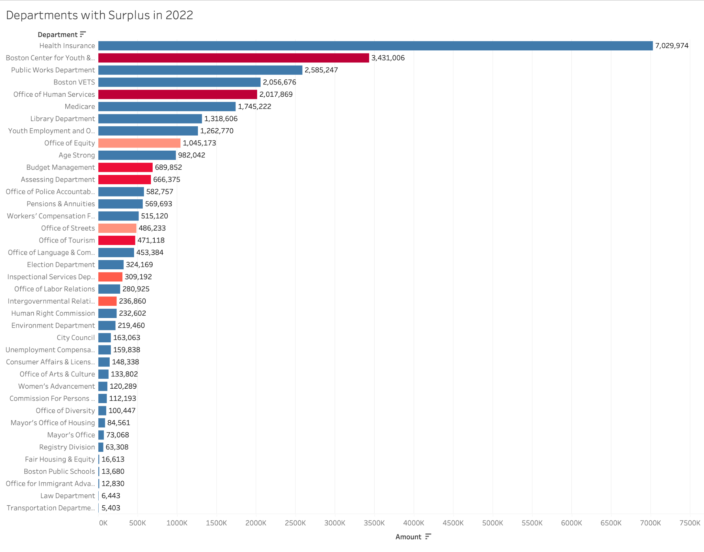
Feasibility Rankings Departments with Positive Surplus in 2022
? | **Center for Youth & Families **Office of Human Services Medicare Payments
9 | **Budget Management **Assessing Department **Office of Tourism Registry
8 | Mayor’s Office
7 | **Intergovernmental Relations Consumer Affairs
6 | **ISD (5/6)
5 | **Office of Equity
4 | **Office of Streets
3 | Age Strong, Election Dept, Women’s Advancement, Public Works
2 | Library Dept, Office of Police Accountability, Office of Language, Office of Arts & Culture, Human Rights Commission, BCYF
1 | Environment, City Council, Commission for Persons with Disability, Mayor’s Office of Housing, Youth Employment & Opportunity, Office of Labor Relations
0 | Pensions & Annuities, Workers Comp, Health Insurance, Boston VETS
These top 10 departments of interest were identified by selecting the departments with the highest feasibility rankings and most surplus in 2022.

Slide 4
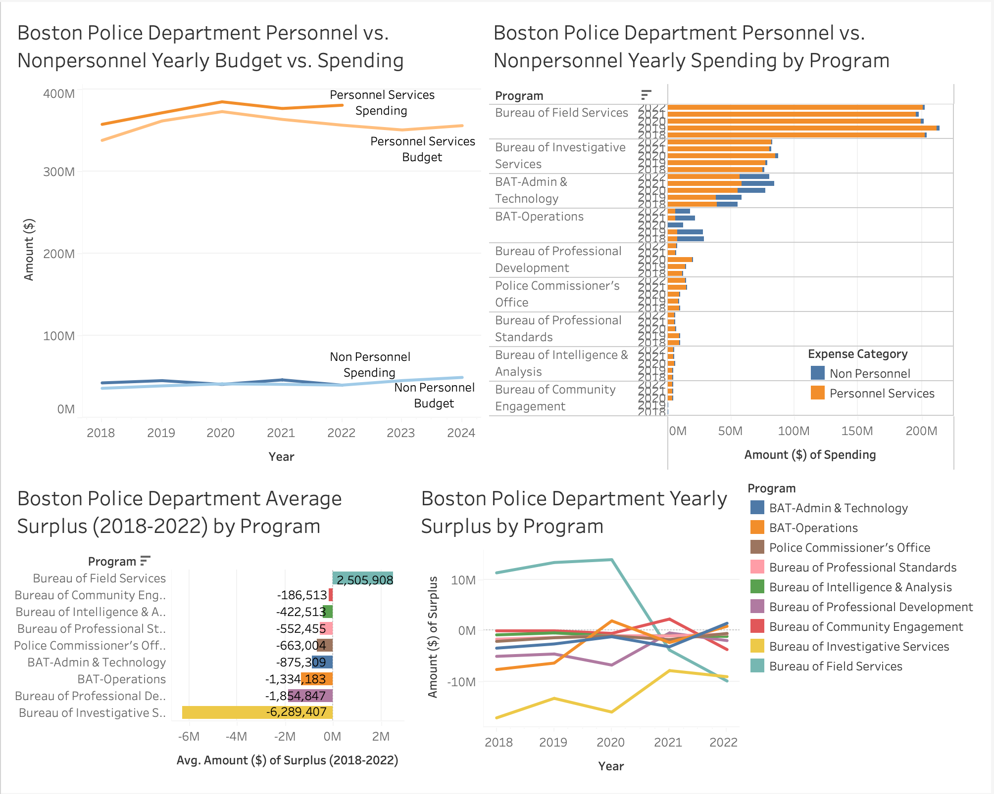
Boston Police Department
Personnel spending is significantly higher than non personnel.
Spending is higher than the budget for both categories.
The Bureau of Field Services program has the highest spending and surplus on average.
In 2022, the programs with the most surplus were BAT Admin & Technology and BAT Operations.

Slide 5
BPD Overtime Analysis
Time Period | Detail Extra Hours | Detail Extra $ | Court Extra Hours | Court Extra $ | Special Events Extra Hours | Special Events Extra $ | Police Request Record Extra Hours | Police Request Record Extra $
2018 | 157823 |  | N/A | N/A | 220014
2019 | 165732 |  | N/A | N/A | 129936 |  | 67736.5
2020 | 136161 |  | N/A | N/A | 72056 |  | 30294
2021 | 150967 |  | N/A | N/A | 117451 |  | 3747.5
2022 | 435754 | 20421786 | N/A | N/A | 108003 |  | 8406.5
2018 - 2020 | N/A | N/A | 57864.5 |  | N/A | N/A | N/A | N/A
2021 - 2022 | N/A | N/A | 29836 |  | N/A | N/A | N/A | N/A

Slide 6
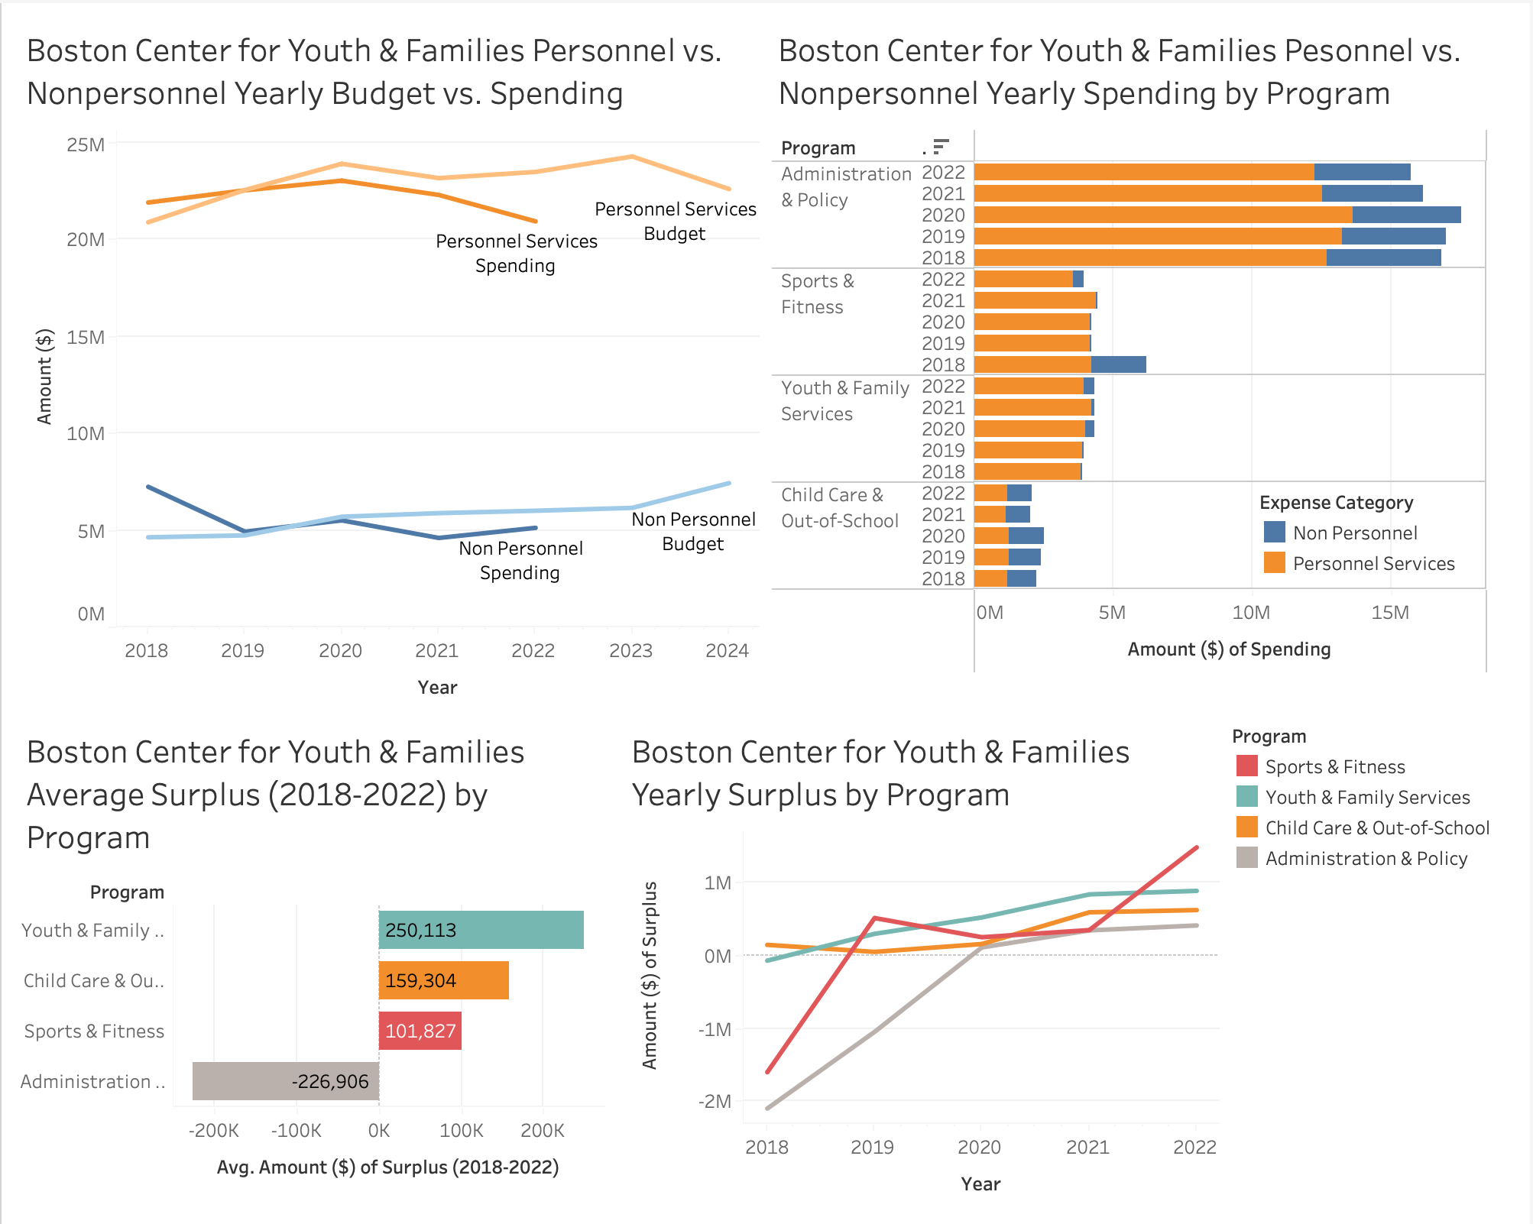
2. Boston Center for Youth & Families
Personnel spending is significantly higher than non personnel.
Spending is less than budget for both categories.
The Administration & Policy program has the highest spending while Youth & Family Services has the highest surplus on average.
In 2022, the programs with most surplus were Sports and Fitness, followed by Youth & Family Services, then Child Care & Out-of-School.

Slide 7
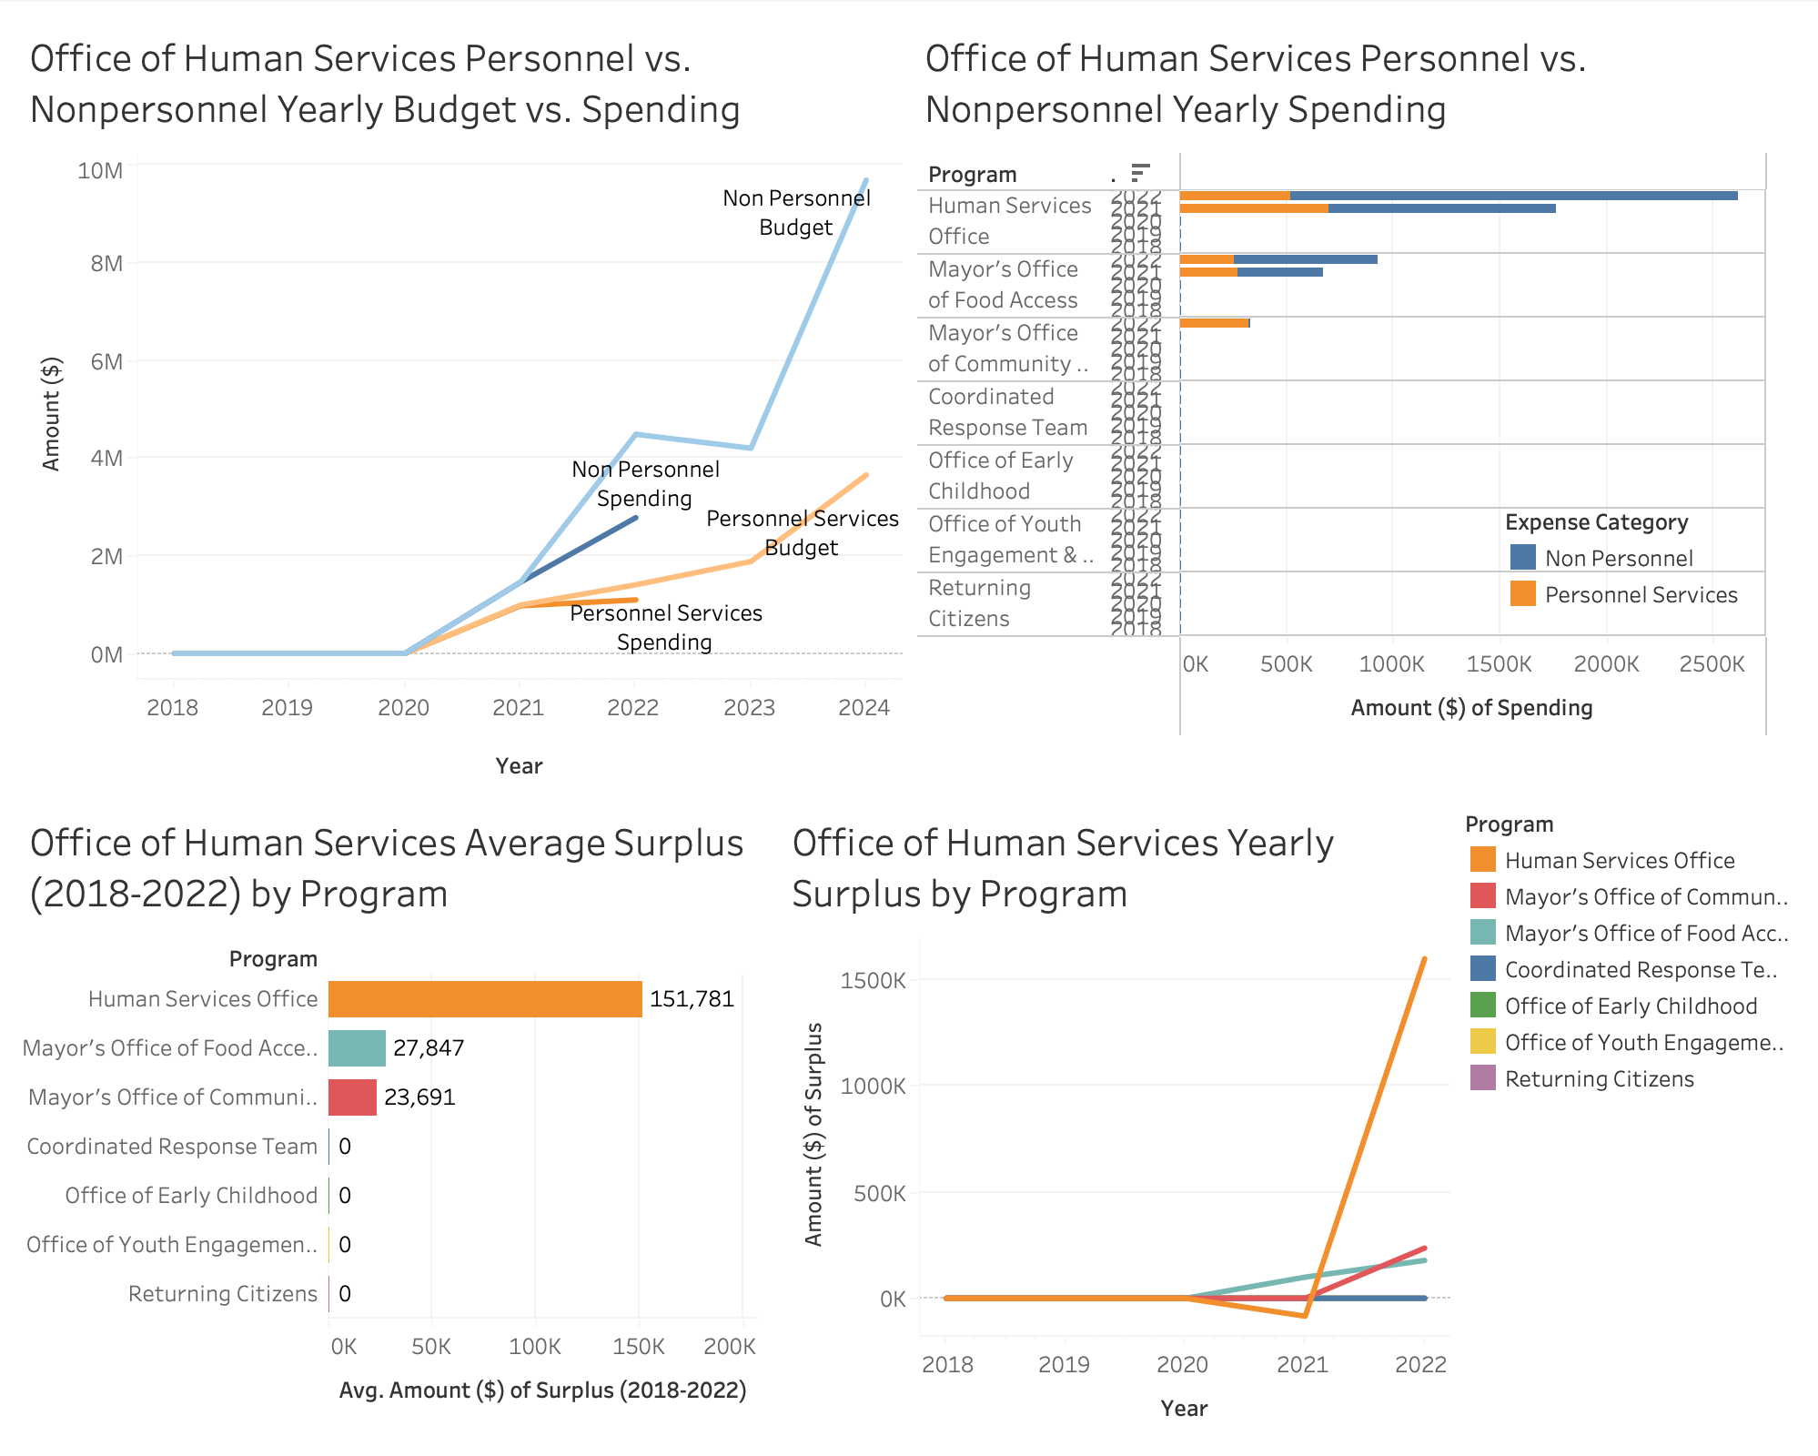
3. Office of Human Services
Nonpersonnel spending is higher than personnel spending.
Spending is less than the budget for both categories.
The Human Services Office program has the highest spending and surplus on average.
In 2022, the programs with the most surplus were the Human Services Office, followed by the Mayor’s Office of Community Safety and the Mayor’s Office of Food Access.

Slide 8
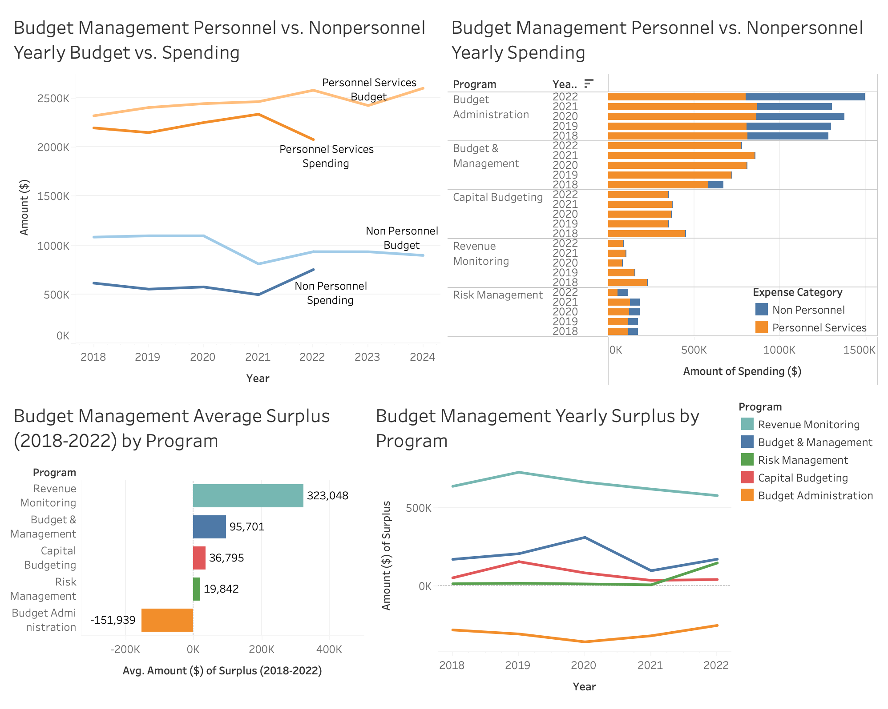
4. Budget Management
Personnel spending is significantly higher than Nonpersonnel spending.
Spending is less than the budget for both categories.
The Budget Administration program has the highest spending while Revenue Monitoring has the highest surplus on average.
In 2022, the programs with the most surplus were Revenue Monitoring, followed by Budget & Management and Risk Management.

Slide 9
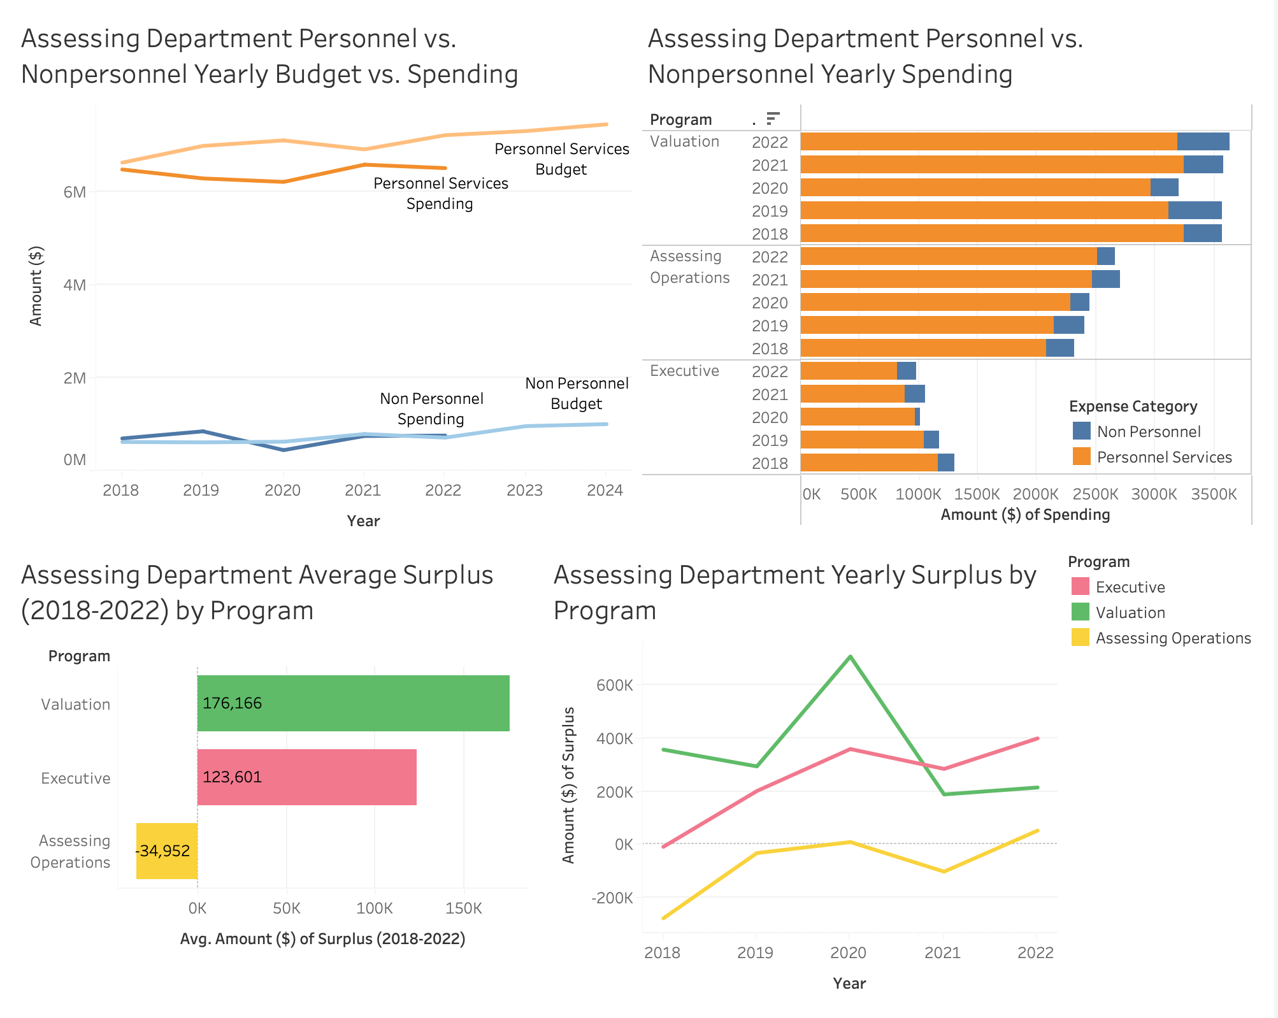
5. Assessing Department
Personnel spending is significantly higher than Nonpersonnel spending.
Spending is less than the budget for Personnel and fluctuates for Nonpersonnel.
The Valuation program has the highest spending and surplus on average.
In 2022, the programs with the most surplus were the Executive program and Valuation program, followed by Assessing Operations.

Slide 10
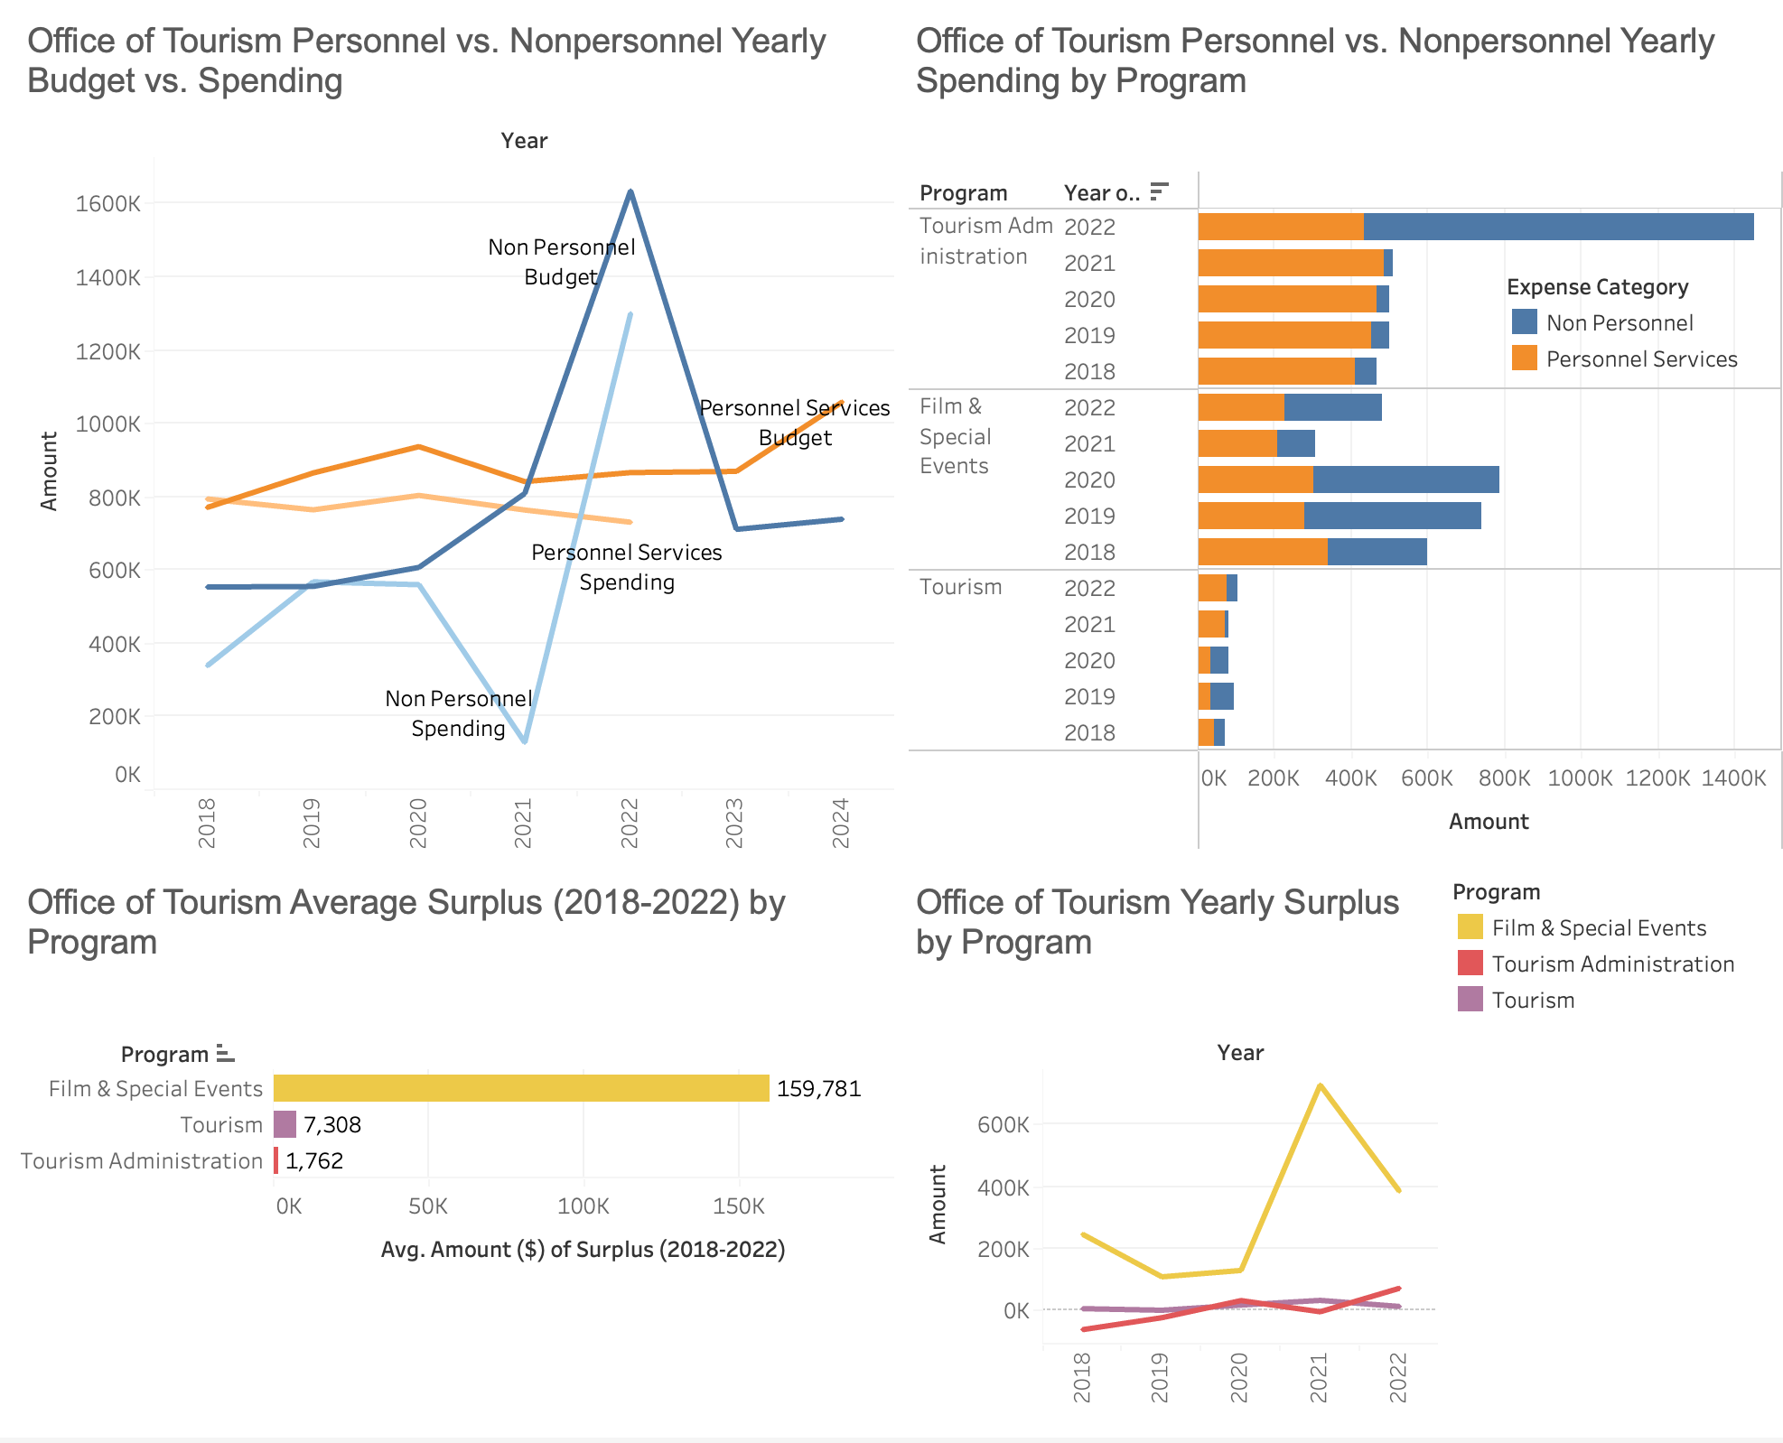
6. Office of Tourism
Personnel spending is typically higher than Nonpersonnel spending, except in 2022.
Spending is less than the budget for both categories.
The Tourism Administration program has the highest spending while Film & Special Events has the highest surplus on average.
In 2022, the programs with the most surplus were Film & Special Events and Tourism Administration.

Slide 11
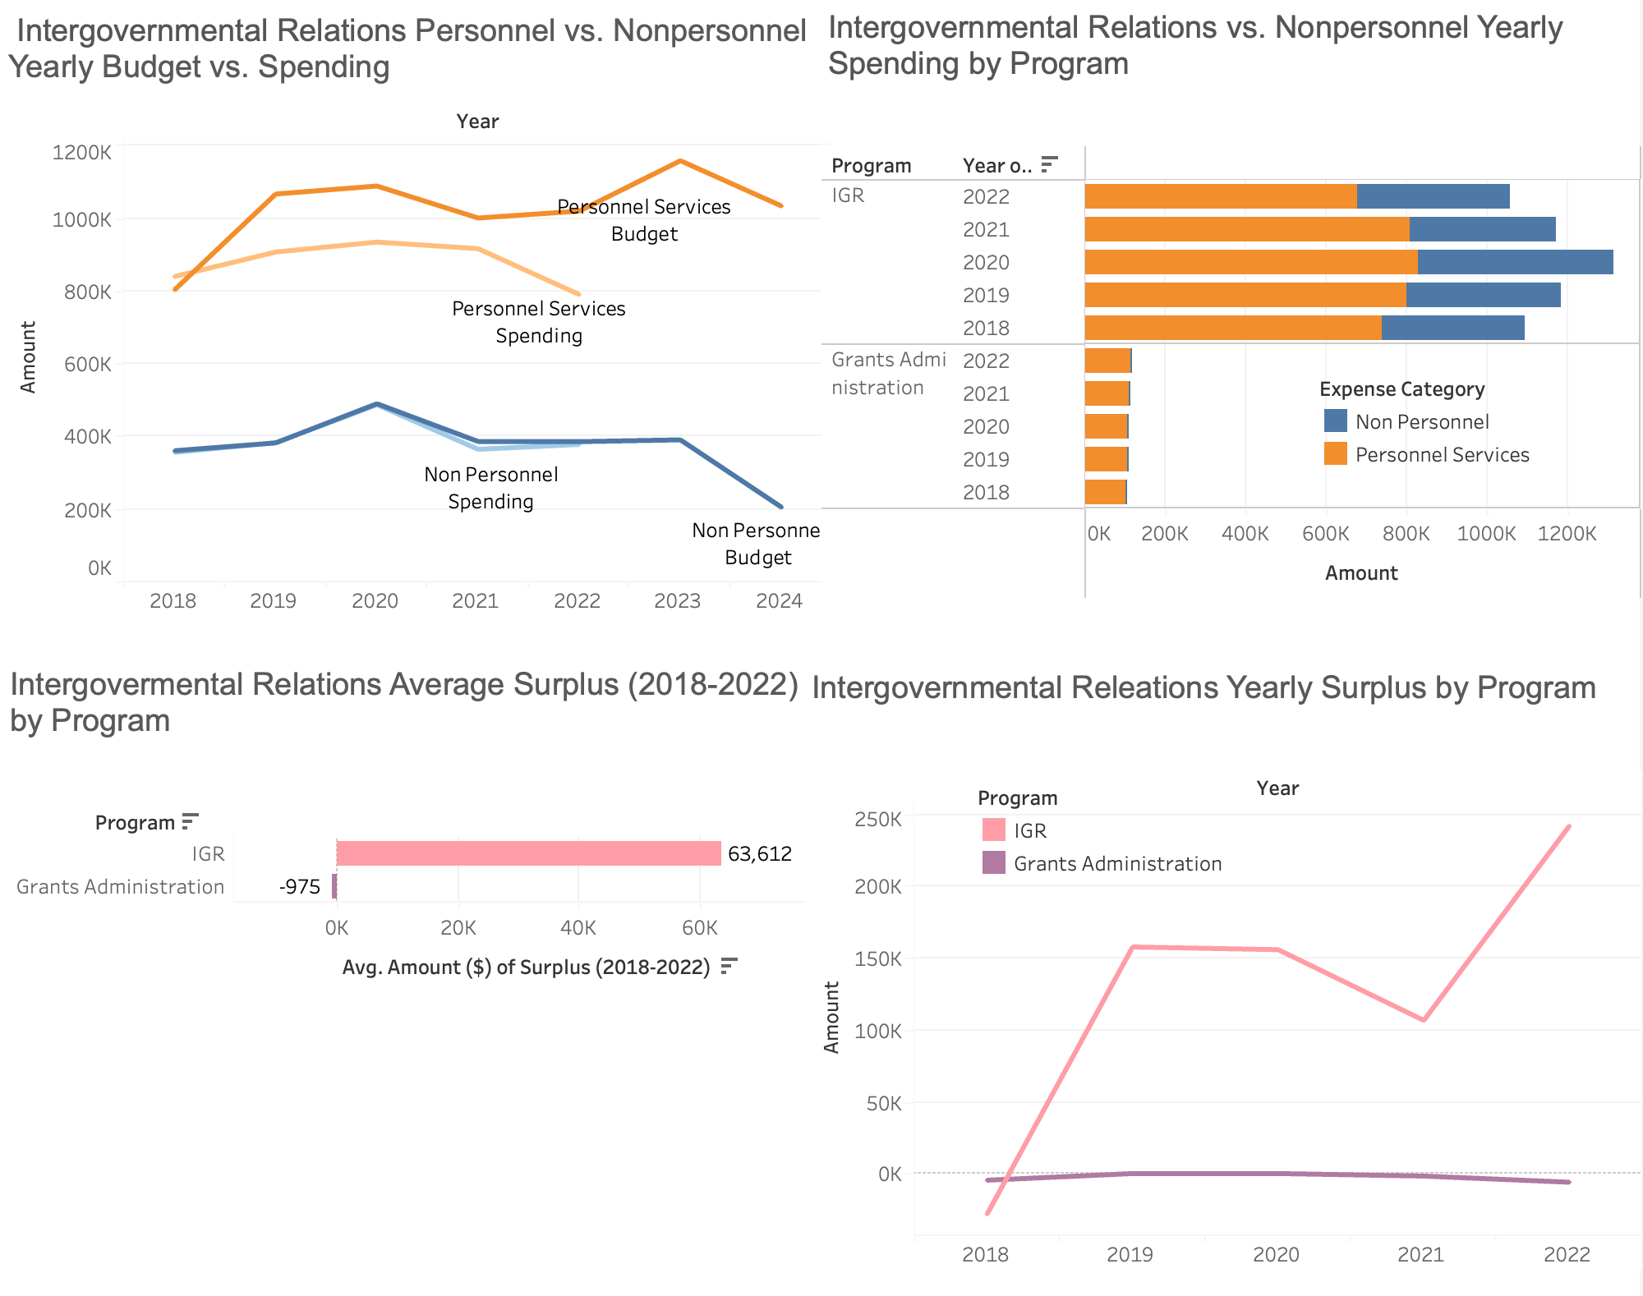
7. Intergovernmental Relations
Personnel spending is significantly higher than Nonpersonnel spending.
Spending is less than the budget for both categories.
The IGR program has the highest spending and surplus on average.
In 2022, the program with the most surplus was IGR.

Slide 12
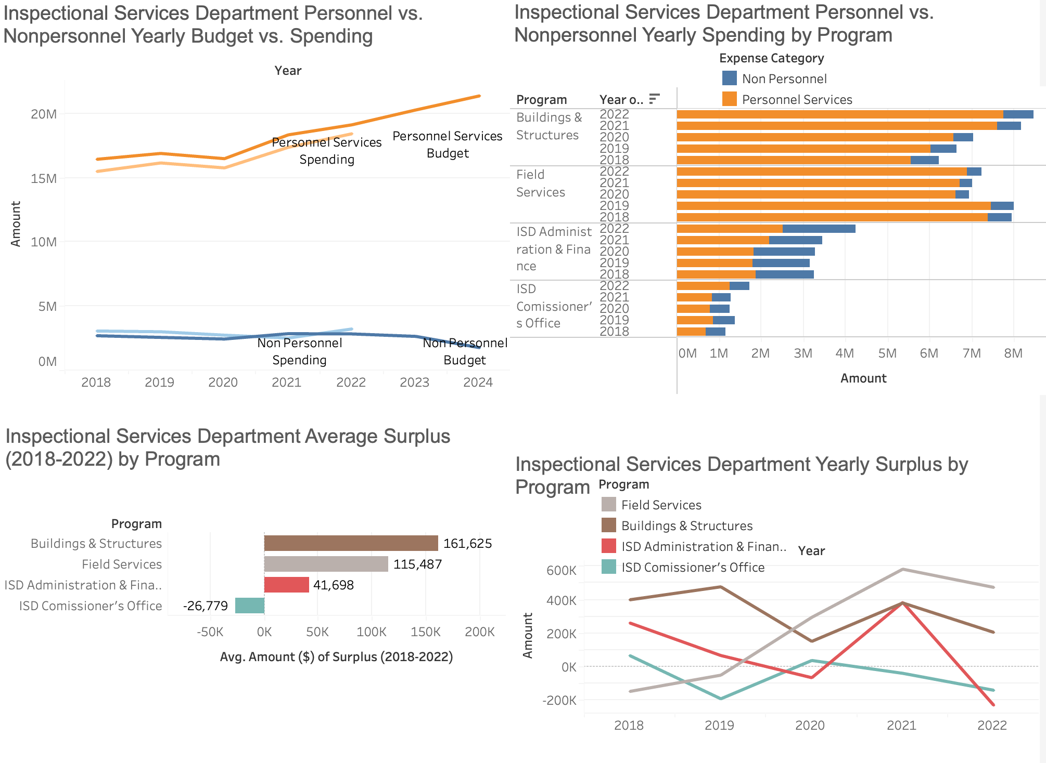
8. Inspectional Services Department
Personnel spending is significantly higher than Nonpersonnel spending.
Spending is less than the budget for both categories, except Nonpersonnel in 2022.
The Building & Structures program has the highest spending and surplus on average.
In 2022, the programs with the most surplus were Field Services and Buildings & Structures.

Slide 13
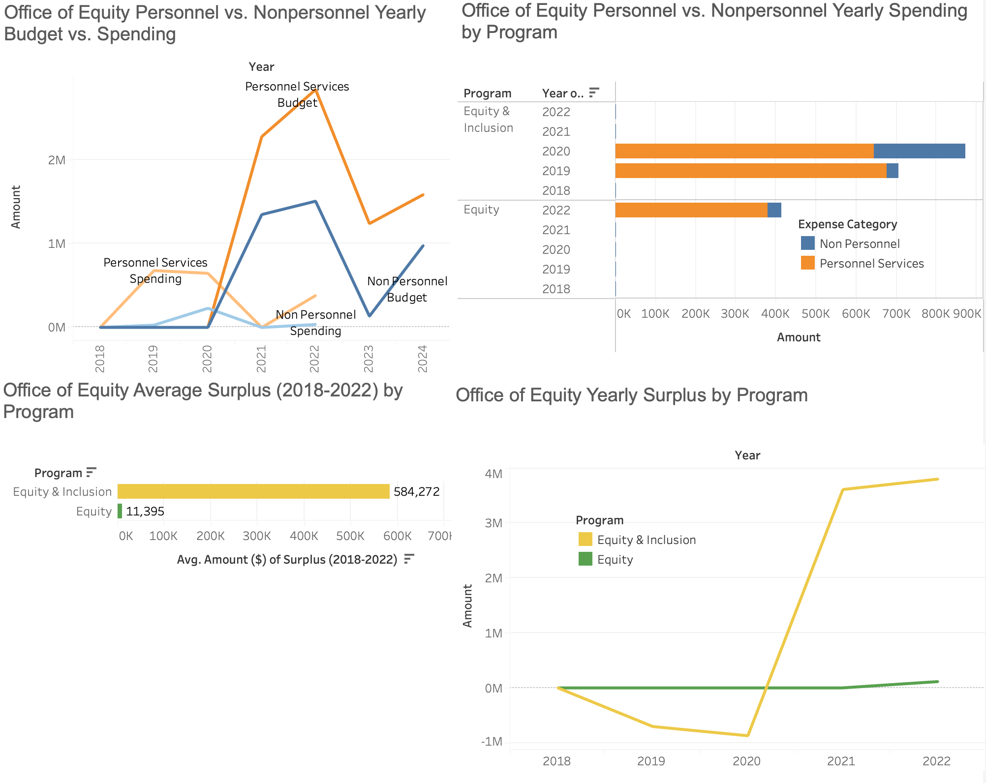
9. Office of Equity
Personnel spending is higher than Non-personnel spending.
Spending is less than the budget for both categories.
The Equity & Inclusion program has the highest spending and surplus on average.
In 2022, the program with the most surplus was Equity & Inclusion.

Slide 14
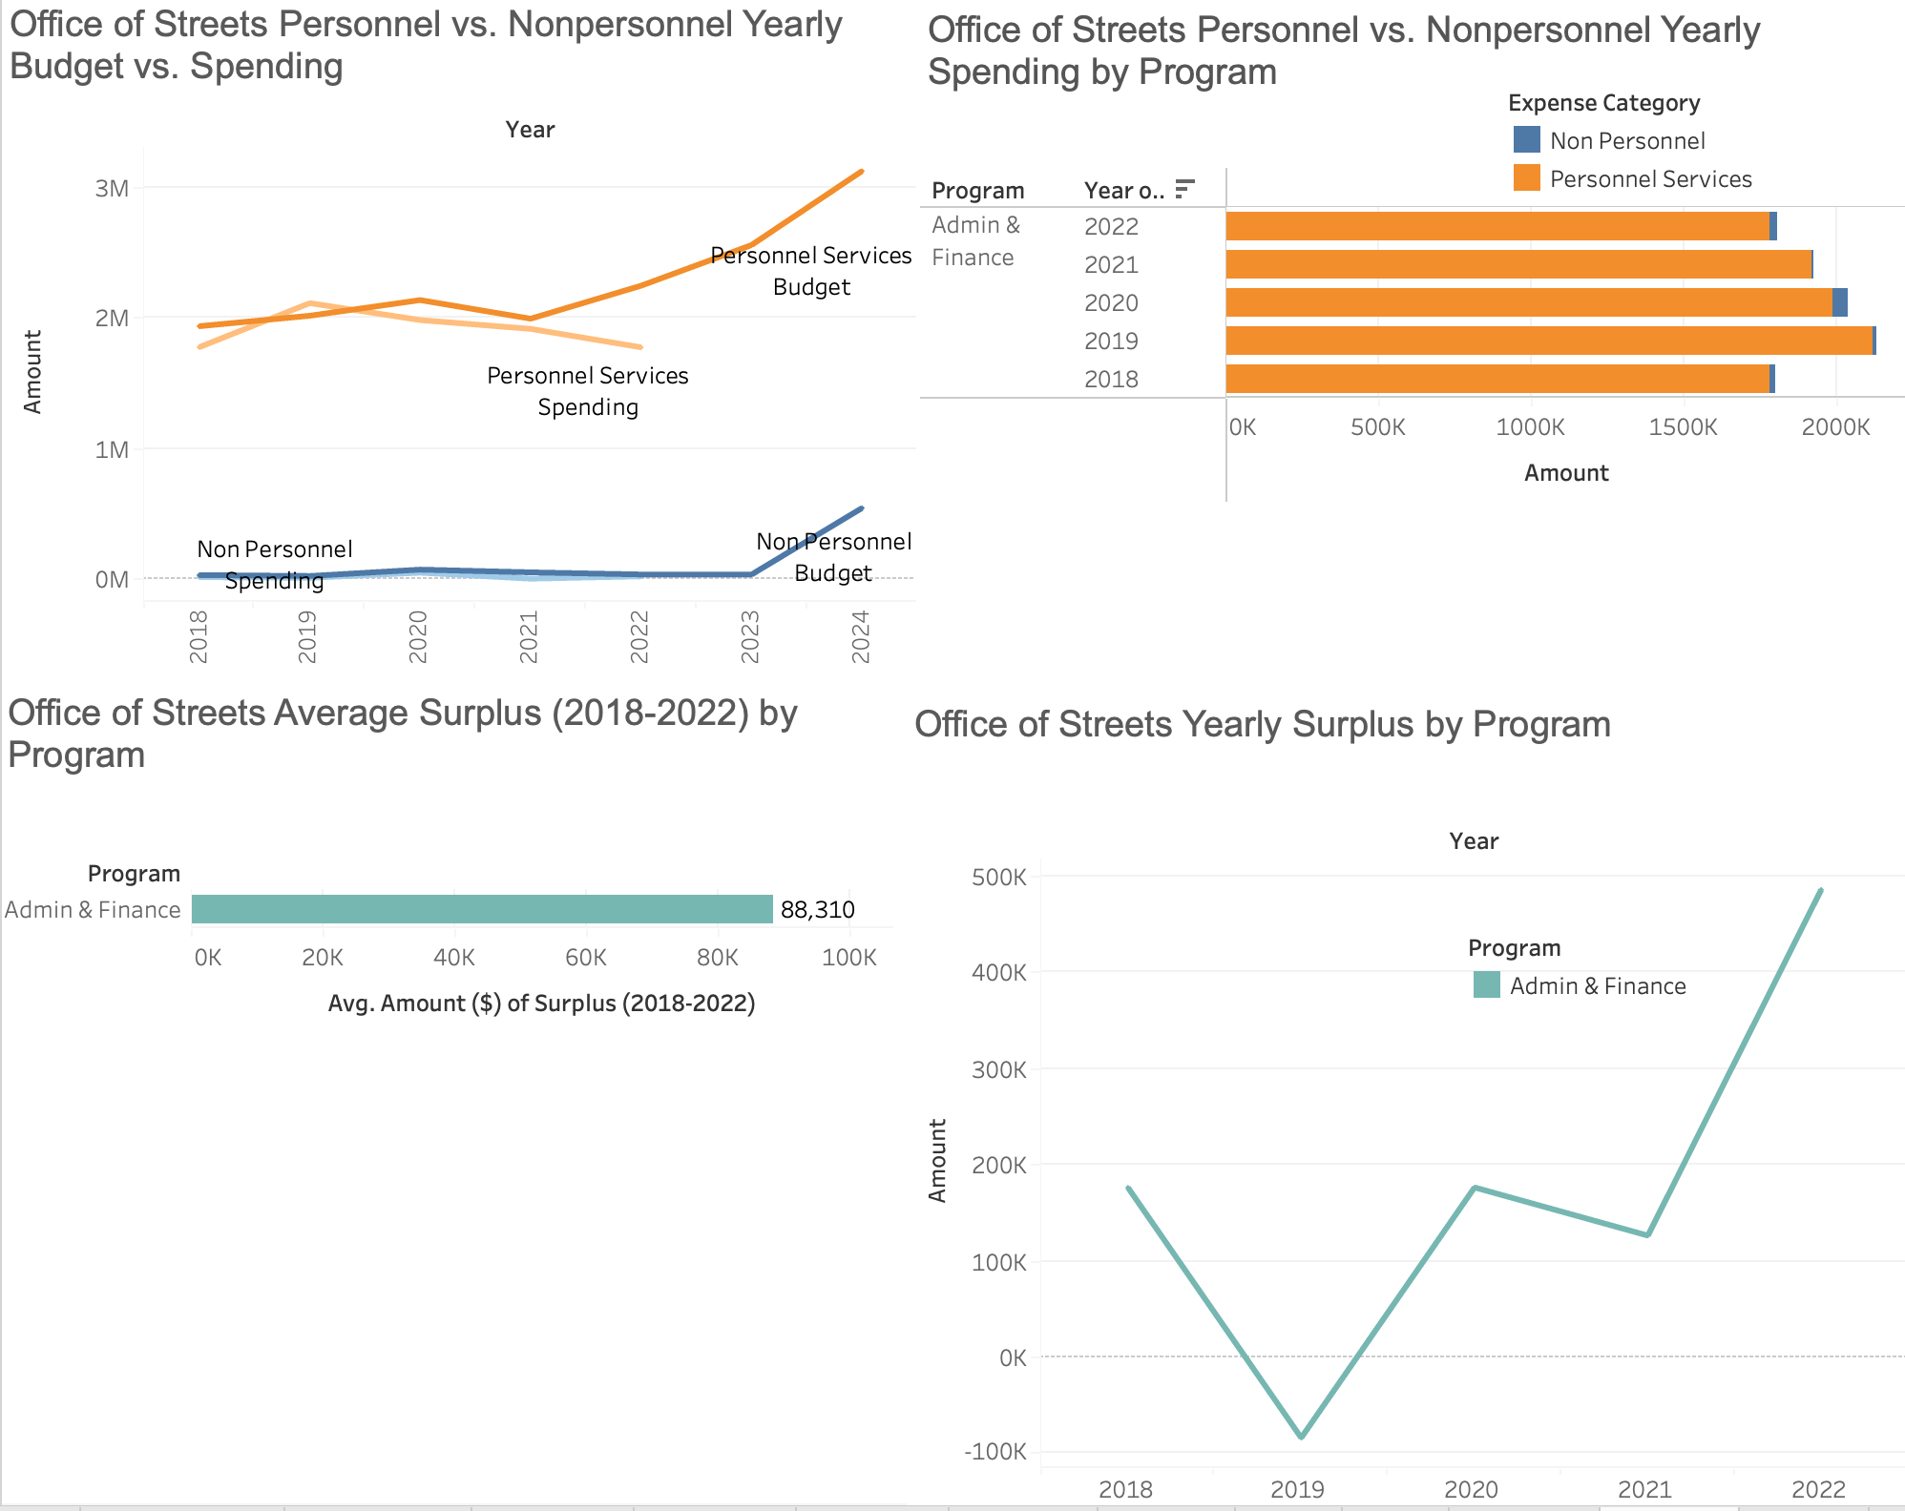
10. Office of Streets
Personnel spending is significantly higher than Nonpersonnel spending.
Spending is less than the budget for both categories.
The Admin & Finance program has the highest spending and surplus on average.
In 2022, the program with the most surplus was Admin & Finance.

Slide 15
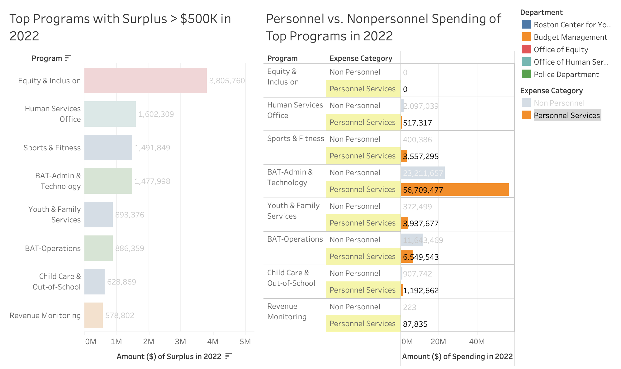
Breakdown of Top Programs
This shows each program’s surplus next to their spending, with personnel spending highlighted as this could be transferred to civilian flaggers, resulting in increased surplus.

Slide 16
Key Takeaways
Personnel spending is significantly higher than Non Personnel spending in almost all of these selected departments of interest, except Office of Human Services.
Top programs of interest in 2022 are Human Services Office, Sports and Fitness, BAT Admin & Technology, Youth & Family Services, BAT Operations, Child Care & Out-of-School, and Revenue Monitoring.
Overtime analysis:
Total OT Hours Per Category:
Detail OT Hours: 1,045,892 (2018 - 2022)
Special Events OT Hours: 647,458 (2018 - 2022)
Court OT Hours: 87,700 (2018 - 2022)
Police Records OT Hours: 135,504 (2019 - 2022)
Next steps:
Deducing total $ overspent after finding pay rates

Slide 17
Q & A

